Slide 2
.NET Today and Tomorrow
Beth Massi – Product Marketing Manager, .NET Platform @BethMassi

Slide 3














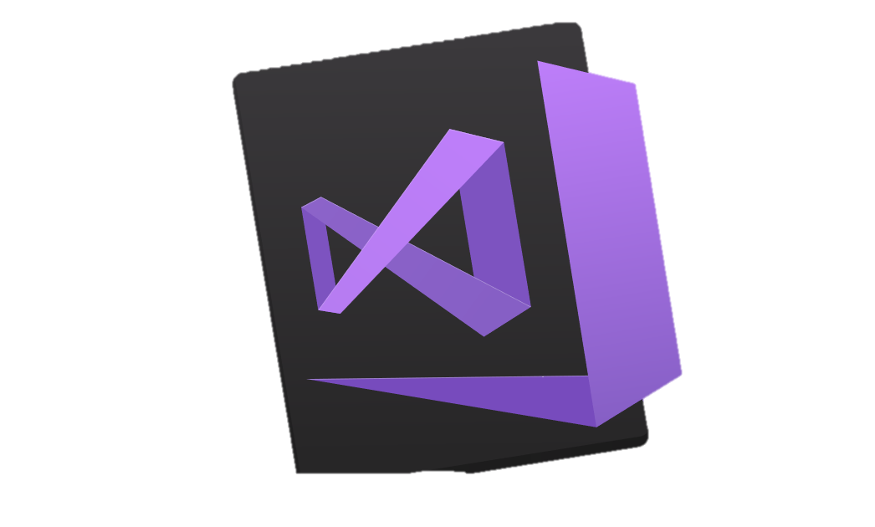
Your platform for building anything
DESKTOP
WEB
CLOUD
MOBILE
GAMING
IoT
AI
.NET
Visual Studio
Visual Studio for Mac
Visual Studio Code
Command Line
Your editor
Notes:
You can build anything with .NET. We’ve made significant investments in .NET over the years as well as unifying the ecosystem to support building literally anything. From desktop to gaming to the cloud, .NET is a general purpose programming platform that enables all kinds of scenarios. Once you learn one, you can easily pick up another.
<CLICK>
What’s more, you can also use your favorite tools and editors to build .NET apps – or use Visual Studio, Visual Studio Code or Visual Studio for Mac.

Slide 4






RayGun
"Using the same-size server, we were able to go from 1,000 requests per second per node with Node.js to 20,000 requests per second with .NET Core."
- John-Daniel Trask, CEO and Co-Founder
AstroReality, Quantum Technologies
"We think .NET Core is mature, very powerful, and a great choice for advanced modern apps."
- Zerlot Ma, Cofounder and CEO
Jet.com Inc.
"The event-driven, microservices paradigm eliminated a lot of the overhead that comes with a service-oriented architecture."
- Mike Hanrahan, CTO
Tencent
“The cross-platform capabilities of .NET Core were very important to us. Also, Microsoft designed .NET Core with a microservice architecture in mind, and that fits right in with our redesign plans.”
- Shanyou Zhang: Senior Software Architect
Age of Ascent, Illyriad Games
"Our game microservices are built using ASP.NET Core which gives us superior performance. ASP.NET is open source, that allows us to contribute back to it if we have any performance issues which Microsoft review and together we make a better product."
- Ben Adams, CTO and Co-founder
NetEase
".NET Core doesn't just help us get to market faster, it also enables our developers to focus on the core logic and what really matters, our players' experience. They don't have to deal with the communication gap and different ways of implementing the algorithm on the back and front end. They can just work on finding better ways to implement their ideas."
- Feng Zhou, Product Director
United Parcel Service (UPS)
"Xamarin allowed us to develop a single code base in C# and deploy the application to two completely different mobile phone ecosystems."
- Scott Hildebrand, Application Development Manager
GoDaddy
“Services can be developed more quickly, perform faster in production, and scale better if they’re written using .NET Core with C#.”
- Jeremiah Gowdy: Principal Software Architect
And many more: microsoft.com/net/customers
Notes:
Our customers have been embracing the productivity in our platform, languages and tools for 15+ years. We’re now gaining existing customers as well as new ones on our cloud-native, cross-platform, and device-native approaches with these new architectures. Here are just a few. There are many more (and their stories) on our website.

Slide 5

Notes:
https://www.youtube.com/watch?v=hUNKUwYH0Tg
Let’s take a look at one of these customer stories.

Slide 6
.NET Open Source & Cross-Platform
750K
+1M
.NET Core developers
New .NET developers
in last year
Notes:
We’re seeing incredible growth in .NET.

Slide 7
“We are honored that Microsoft has made it a priority to improve ASP.NET’s performance in these benchmarks, and in so doing, improve the performance of all applications built on ASP.NET.
We believe this to be the most significant performance improvement that this project has ever seen.”
- TechEmpower

Slide 8
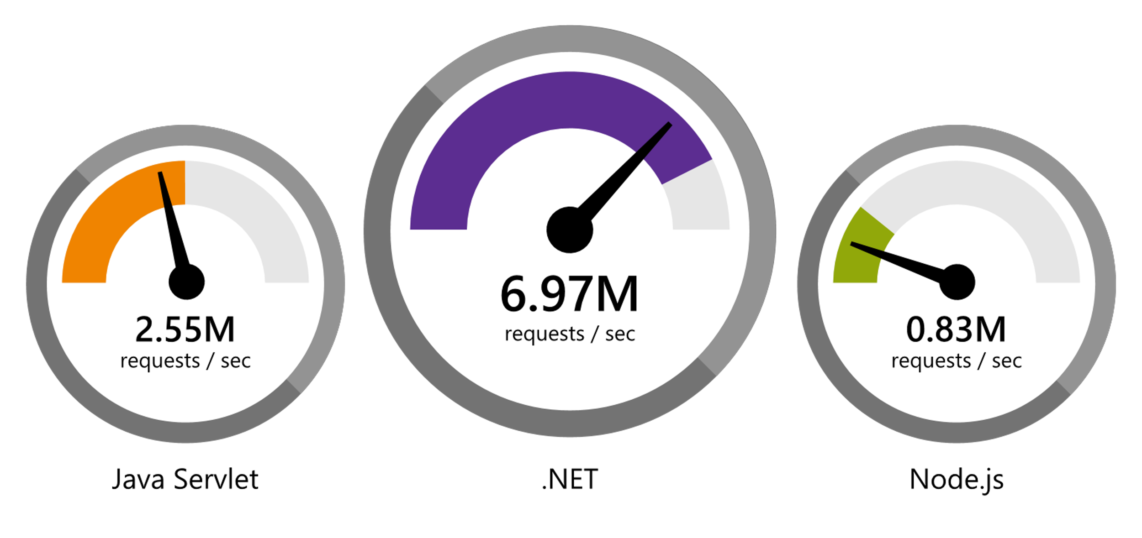
.NET Faster than any other popular framework
Data sourced from official tests available at TechEmpower Round 16.
“Using the same-size server, we were able to go from 1,000 requests per second per node with Node.js to 20,000 requests per second with .NET Core.“ — Raygun
www.dot.net/customers
Notes:
We’ve made significant investments in the platform especially in terms of performance.
The popular TechEmpower benchmark compares web application frameworks with tasks like JSON serialization, database access, and server side template rendering - .NET performs faster than any other popular framework.
https://www.techempower.com/benchmarks/#section=data-r16&hw=ph&test=plaintext
In the latest benchmarks on raw platform performance, .NET is more than 8 times faster than Node.js

Slide 9
.NET Core 2.1 on TechEmpower
REQUESTS / SECOND
+15%
+18%
+147%
Data sourced from official tests on TechEmpower round 16.
Notes:
These numbers show the micro framework tests (as opposed to the raw platform tests) which makes them more realistic.
Call out the incredible performance increase in the REAL WORLD data access scenario.

Slide 10
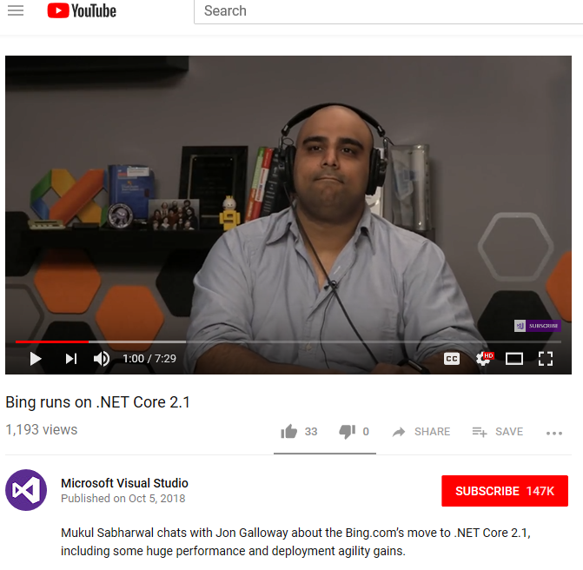
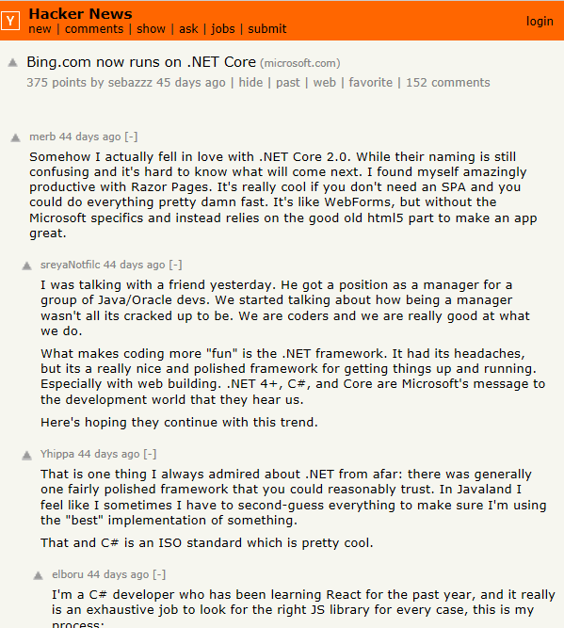
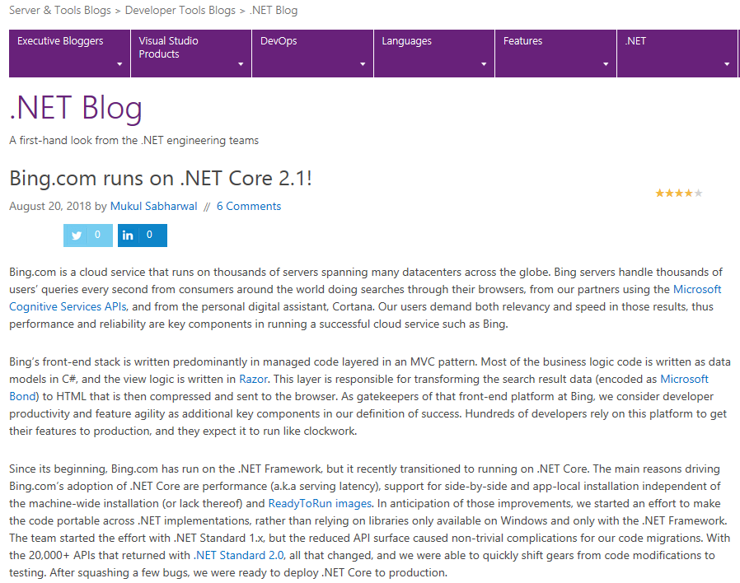
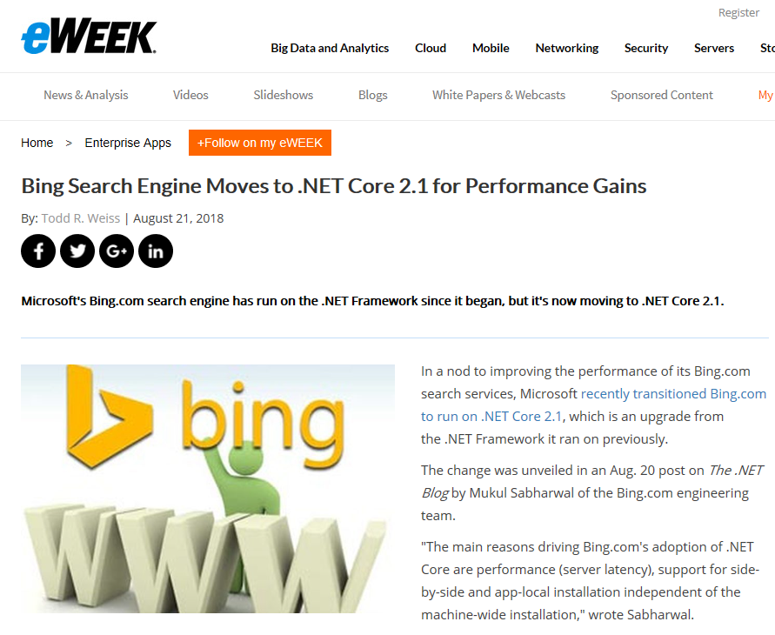
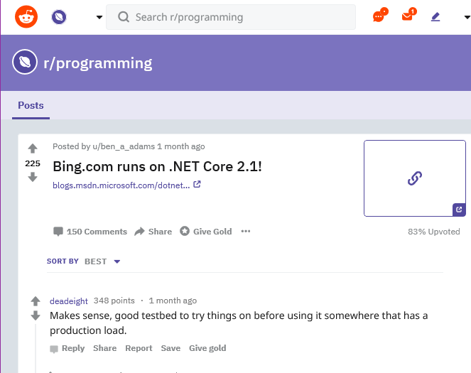
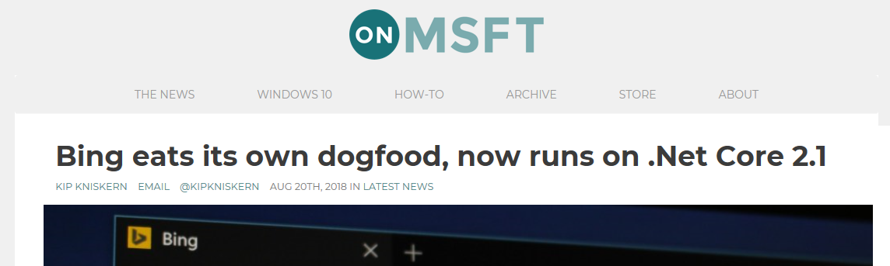
Bing.com Runs on .NET Core 2.1
Notes:
Bing.com moved to .NET Core 2.1 and saw incredible performance gains. It made a wave of news. Check out the interview with the lead engineer: https://channel9.msdn.com/Events/dotnetConf/2018/S318

Slide 11

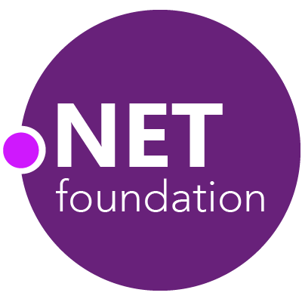
Steeltoe
.NET Core
Microsoft Web Protection Library
MSBuild
DotNetNuke
ASP.NET AJAX Control Toolkit
ASP.NET Core
SourceLink
Microsoft Azure WebJobs SDK
Salesforce Toolkits for .NET
nUnit
MVVM Light Toolkit
IronPython
Mailkit
WorldWide Telescope
Nancy
Open XML SDK
.NET SDK for Hadoop
MvvmCross
MEF
JSON.NET
Mimekit
xUnit
ASP.NET Web Pages
NuGet
IdentityManager
Couchbase Lite for .NET
ML.NET
iOS
macOS
Entity Framework
.NET ECOSYSTEM
WCF
ILMerge
Xamarin.Mobile
ASP.NET SignalR
Infer.NET
.NET Micro Framework
Open Live Writer
Mono
Xamarin.Auth
Xamarin SDK
Orchard CMS
OWIN Authentication Middleware
ProtoBuild
IdentityServer
Microsoft Azure SDK for .NET
.NET Compiler Platform ("Roslyn")
Prism
ASP.NET Web API
Cake
Orleans
Kudu
Cecil
LLILC
Umbraco
System.Drawing
ASP.NET MVC
Notes:
The .NET Foundation is our center of gravity for open development and collaboration around the .NET ecosystem. The .NET Foundation has over 50 projects and hundreds of repos under its stewardship. Open Source Software foundations provide protection, support, services and best practices for helping each project be successful and to grow the ecosystem of people and software.

Slide 12
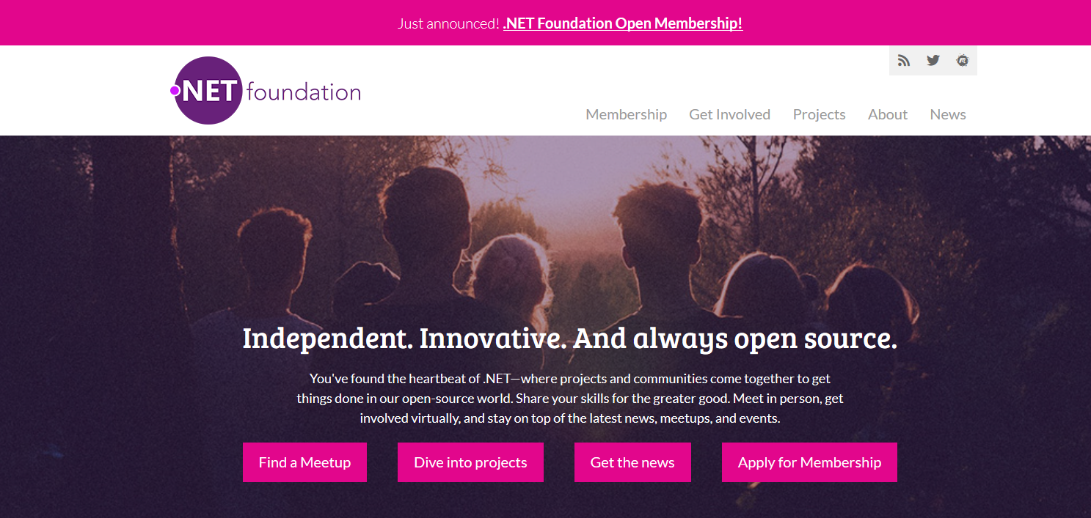
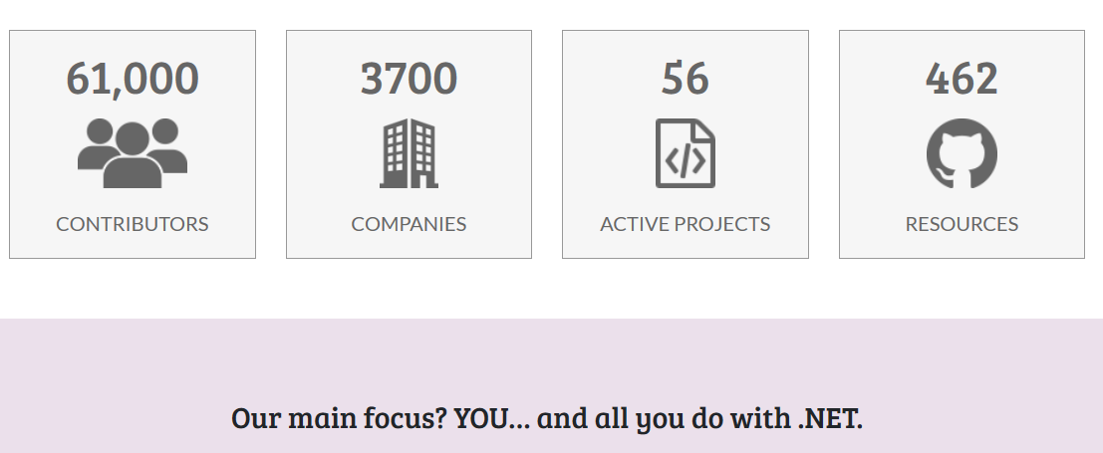
www.dotnetfoundation.org
Notes:
The ecosystem starts with you! Get involved by joining (or running!) a meetup. Contribute to projects, or just read the news. Visit www.dotnetfoundation.org
Join the foundation as a member and vote for the board.

Slide 13
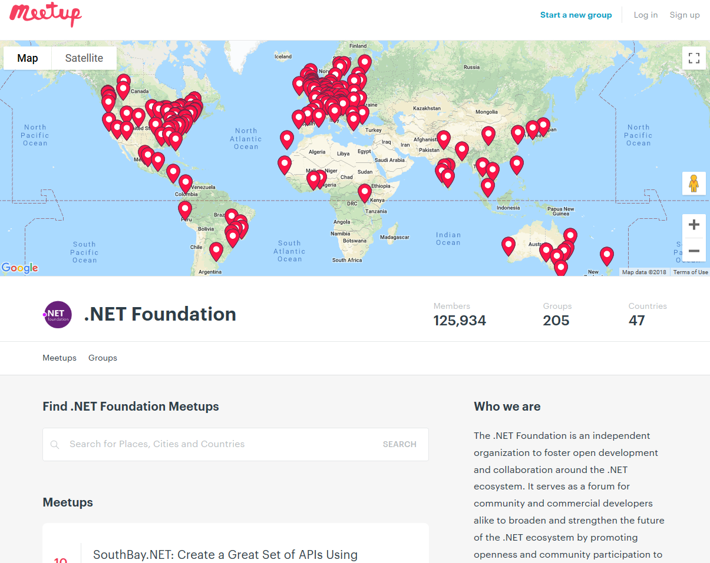
Groups
225
Members
164,767
Countries
52
Join us: meetup.com/pro/dotnet
Notes:
We’re a huge community and the .NET Foundation is key to help foster it. We have over 4 million developers worldwide and .NET has grown its developer base by 1 million over the last year. There are meetups all over the world that speak on all sorts of .NET topics and application development. Here are the ones on meetup.com.

Slide 14

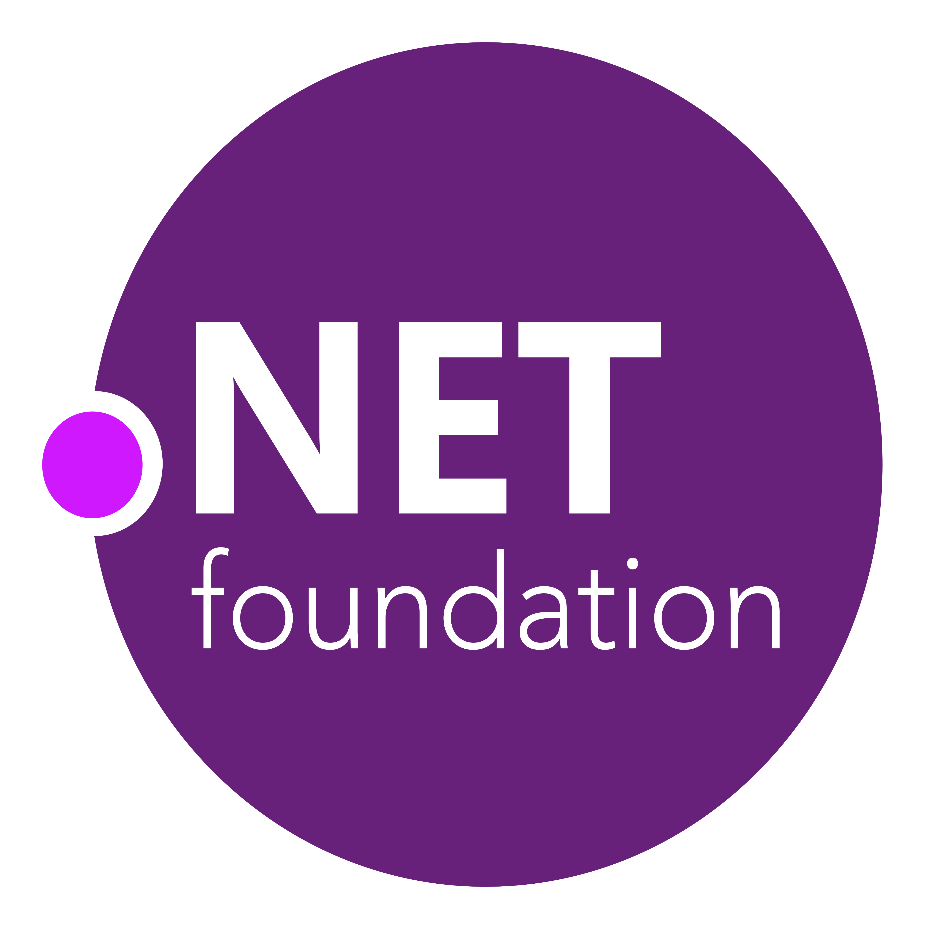
87% contributors outside Microsoft
.NET open source momentum
61,000+ accepted PRs from community
Notes:
We’re proud of all the innovation in .NET Core and the surrounding ecosystem, but we’re also proud of its momentum in the open source community.
There are a number of open source projects that make up the .NET platform ecosystem, and it’s amazing to see the engagement. 87% of the people who contribute to the .NET platform don’t work at Microsoft.
And these open source developers have made over 61 thousand code contributions back to the platform.

Slide 15
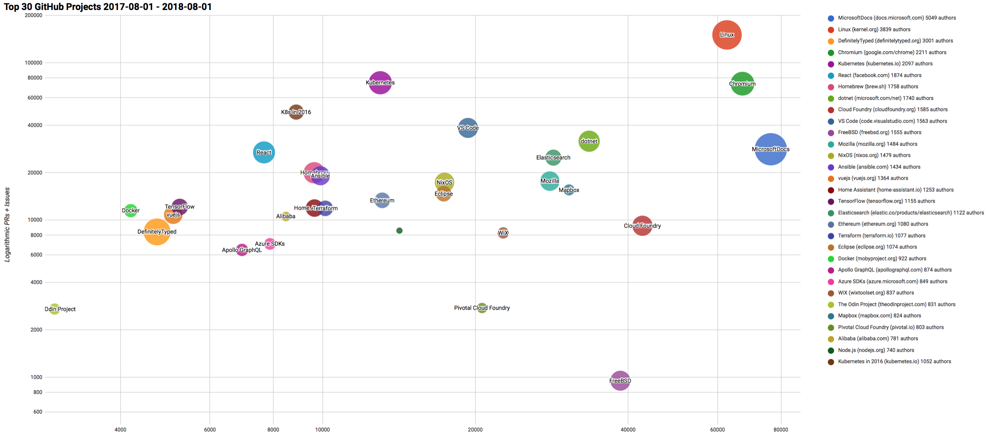

Top 30 Highest Velocity OSS Projects on GitHub
https://www.cncf.io/blog/2017/06/05/30-highest-velocity-open-source-projects/
https://raw.githubusercontent.com/cncf/velocity/master/charts/top30_20170801_20180801.png
Notes:
Jim Zemlin, Executive director of Linux foundation said “There are 10’s of millions of open source projects, invest in the ones with sustainable ecosystems”. .NET is one of those projects. CNCF tracks the top 30 highest velocity open source projects. This is a logarithmic scale to measure OSS project velocity with commits on the X axis and PRs and issues on the Y axis, with # of authors indicated by the size of the circle. The farther upper right the more activity a project has. Linux Kernel is #1, followed by Chromium, Kubernetes and Microsoft Docs. Notice .NET is the #1 application framework.

Slide 16

.NET Open Source Journey
.NET
Aug. 2017
.NET Core 2.0 released
2001
ECMA 335
2008
ASP.NET MVC (web platform) open source
April 2014
.NET Compiler Platform (“Roslyn”) open source
.NET Foundation founded
Fall 2019
.NET Core 3.0
2016
Mono project joins .NET Foundation
2002
NET 1.0 for Windows released. Mono project begins
Dec. 2018
.NET Core 2.2 released
.NET Core 3.0 preview WinForms and WPF go open source
Nov. 2014
.NET Core (cross-platform) project begins
Notes:
<talk to the journey, key milestones below>
Dec 2001-Feb 2002.
A new platform is born. Along with HP, Intel and others, the ECMA-335 standard was created that defined a common language infrastructure to support multiple programming languages. C# and Visual Basic.NET were released and F# came later in 2007, but there are over 20 other .NET languages today. Visual Studio .NET was released and included C#, VB, C++ development all in one box. This was the first IDE that was truly integrated across multiple languages.
Mono project begins. The CLI spec gave others the ability to create their own .NET implementations. Even though Microsoft built the first .NET Framework for Windows-only, the spec was intentionally portable across OSes and chipsets. The Mono project began, spearheaded by Miguel de Icaza, with the goal to implement Microsoft's new .NET development platform on Linux and Unix-like platforms. Later, Miguel started Xamarin which focused on cross-platform, native, mobile development with C#, built upon Mono. This allows developers to use C# and .NET to build apps for iOS and Android. Unity games development also emerged from Mono.
2008.
ASP.NET MVC web development stack is released to CodePlex as open source. This was the first application development framework from Microsoft to be released as open source. The underlying runtime and compilers were still closed however.
2014.
Hell freezes over & pigs fly. Early 2014 at Microsoft’s BUILD conference, Anders Hejlsberg, the father of C#, releases the .NET Compiler Platform “Roslyn” as open source on stage. Later in November, .NET Core project begins in the open. The technology world is shocked, and the .NET community is excited. .NET Core is a new cloud-native implementation of .NET that is geared for cross-platform, hyper-scale services as well as small IoT devices. It’s meant to bring .NET into the next 15 years of computing. And the community has been extremely supportive….
2016.
Mono comes home. In early 2016, Microsoft finally acquires Xamarin and brings Miguel de Icaza into Developer Division. Mono joins the .NET foundation and is officially supported and contributed to by Microsoft. The Microsoft community officially meets the Mono community.
2017.
.NET Core 2.0 Released. Our cross platform and open source implementation of .NET finally releases to the world with unified tooling support across multiple operating systems and editors.
2018.
Winforms and WPF go open source. At Microsoft Connect 2018 we announced the open sourcing of Windows Forms and WPF desktop frameworks. We’ve seen incredible contributions and activity since. The community now has the power to guide the direction of these frameworks.
2019
.NET Core 3.0 released. .NET Core 3.0 brings Windows desktop workloads to the .NET Core runtime which will allow self contained EXEs, side-by-side installs, and faster performance.

Slide 17
Now Available .NET Core 2.2!
www.dot.net

Slide 18
.NET Core 2.2 Themes
Improved Web API Development
Microservices and Azure
Continued Performance Improvements

Slide 19
.NET Core 2.2 Major Features
.NET Core
Spatial extensions for SQL Server and SQLite providers
Reverse engineering of database views
Collections of owned entities
Query tagging
ASP.NET Core
Multi-tier JIT compilation (opt-in)
SQL Connection token auth
Windows ARM32 support (Nanoserver and IoT Core)
EF Core
Template updates: Bootstrap 4, Angular 6
Web API improvements, including API security
HTTP/2
IIS in-process hosting
Health checks
Endpoint routing
SignalR Java client now available (.NET Client in 2.1)

Slide 20
Demo: .NET Core 2.2
Notes:
Swagger support
Http-Repl
SignalR client-to-server streaming

Slide 21










Azure is YOUR cloud
.NET cloud apps run best in Azure
Azure Storage
Azure Cosmos DB
Azure App Service
Azure Functions
Azure App Insights
Azure Service Fabric
Azure SignalR Service
Azure Virtual Machines
Azure SQL Database
Azure Cognitive Services
Azure Kubernetes Service (AKS)
And many more…
Extend apps with serverless, event driven tasks
Commoditized AI
Fully managed platform perfect for running .NET Framework and .NET Core web aps and services
Application performance and usability monitoring
Build native .NET, fully managed, scalable microservices
Relational Database
Non-Relational Database
Fully managed real-time web functions, like chat, gaming, tickers, collaboration and more
Store anything. Great for binaries
Container orchestrator for Linux workloads (.NET Core)
Notes:
Azure is the .NET developer’s cloud. There are hundreds of developer services accessible to C# developers. From fully managed platform as a service with App Service, to serverless event driven Azure functions to relational and non-relational databases, the .NET developer is a primary target customer. We make developing against these services as integrated and productive as a .NET developer would expect.

Slide 22
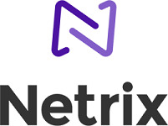
Azure SignalR Service
Add real-time web functionalities easily with Azure and .NET Core
Enable via “services.AddSignalR().AddAzureSignalR()”
Fully managed service
“By using Azure SignalR Service, we gain the best practices of built-in security and scalability—a comfort for our clients and a huge win for us.” - Lars Kemmann: Solutions Architect, Netrix
No more worries about capacity provisioning, scaling, or persistent connections
Native SignalR development
</>
Use ASP.NET Core SignalR to build real-time experiences such as chat, stock tickers, live dashboards, and instant broadcasting

Slide 23
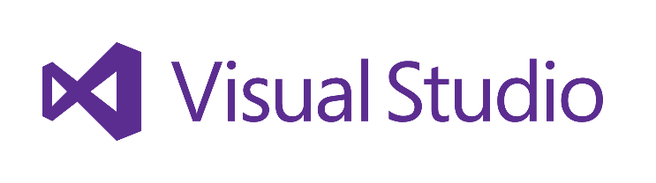
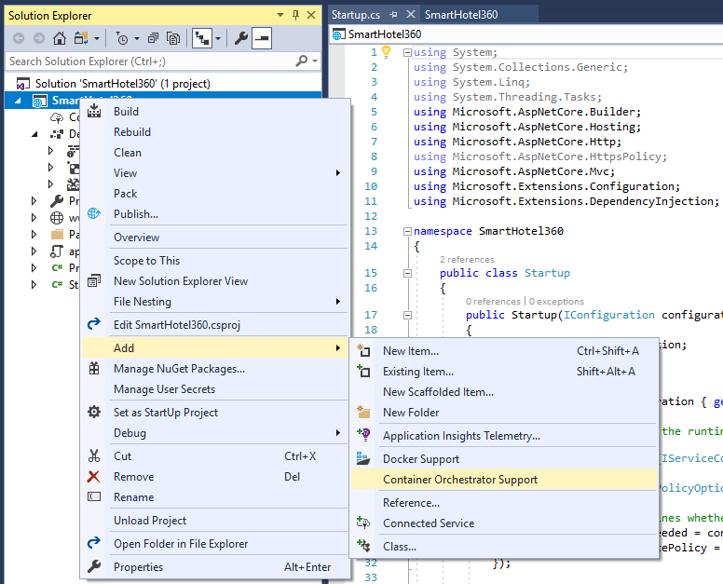
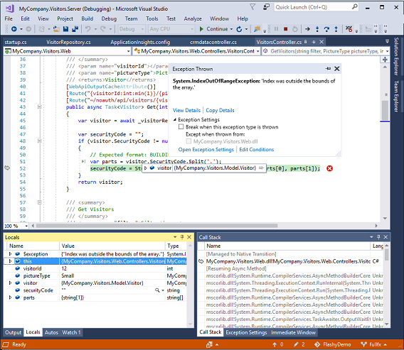
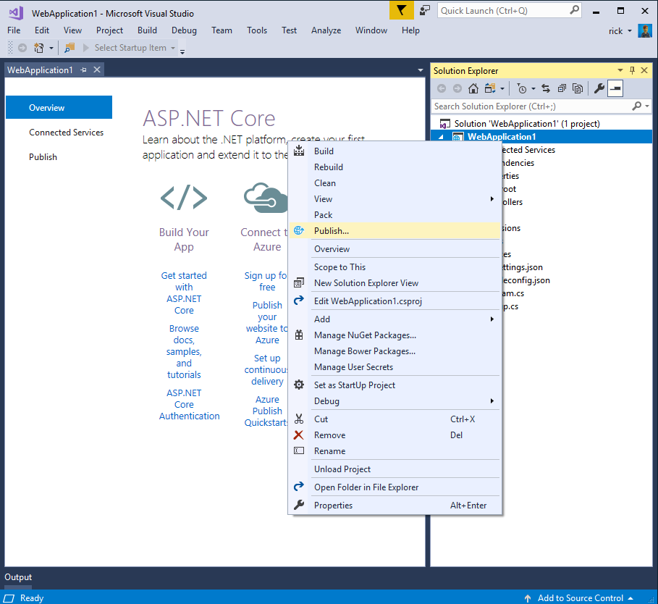
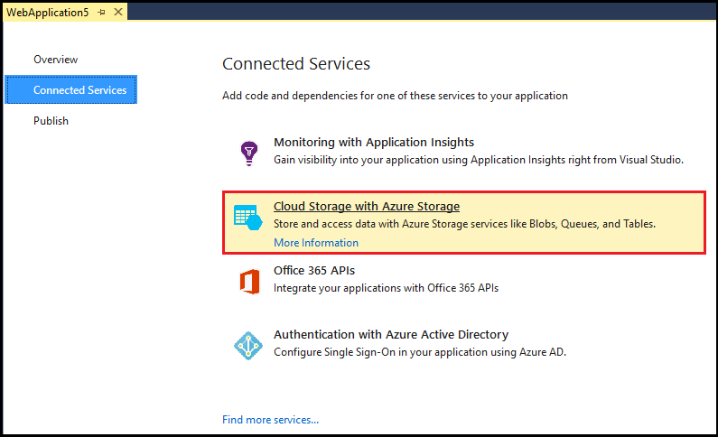
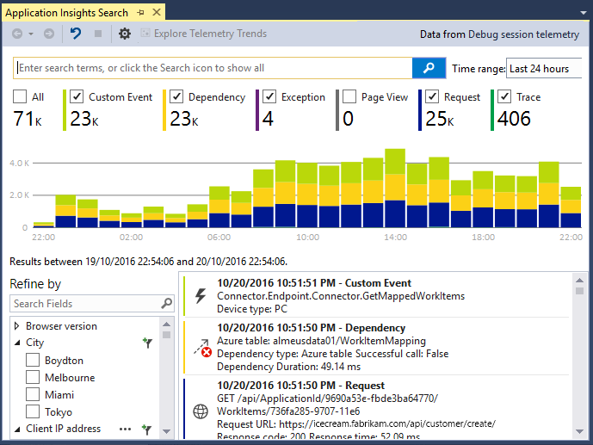
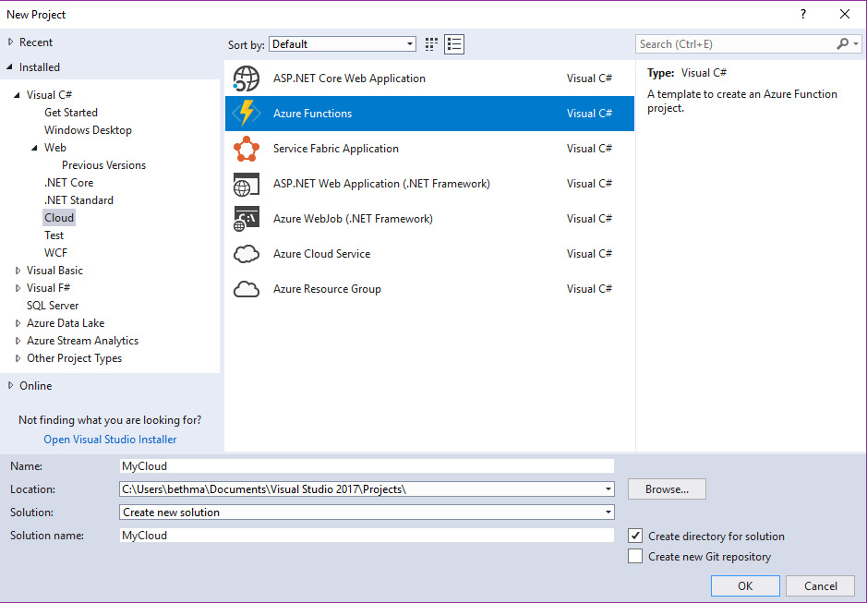
Accelerate your
development
cloud
Seamless Azure Integration
Publish directly to Azure without leaving the IDE
Connected Services
A new experience for easily discovering and extending your app with cloud services
Container Tools
Quickly add Docker compose and container orchestrator support to your apps
App Insights with Code Lens
Get a 360° view of your app that includes availability, performance and user behavior
Azure Functions
Get started quickly with serverless using templates and tools for development and debugging
Snapshot Debugging
Production debugging your cloud apps has never been so simple
Notes:
Of course there are a lot of great tools in Visual Studio for building applications. But what’s even better is the latest tools for building, monitoring, and managing your cloud applications. Whether that’s web applications hosted in App Service, or serverless Azure functions with C#, or containerized apps with Docker, we have you covered.

Slide 24
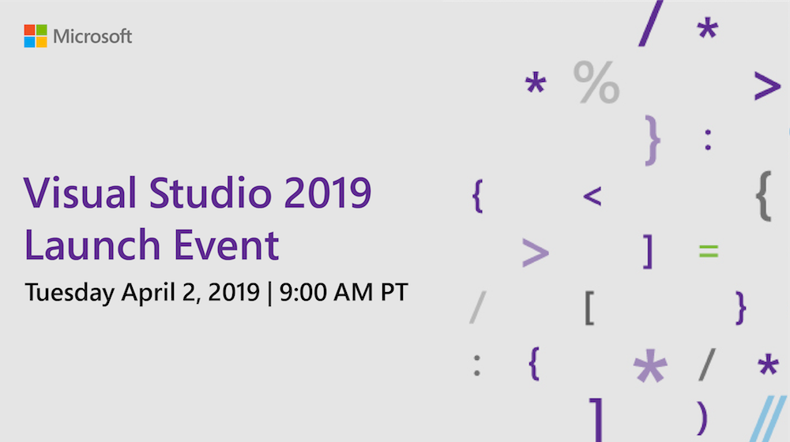
launch.visualstudio.com

Slide 25
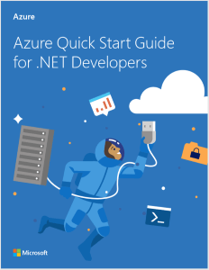
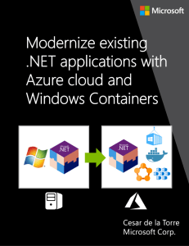
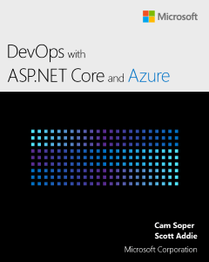
Get Help Migrating your .NET app to Azure
aka.ms/migratetothecloud
Download free e-books and assessment resources….
Apply for free assistance from the .NET team!

Slide 26
Demo: Azure <3 .NET
Notes:
Getting started with an Azure DevOps pipeline and a GitHub repository

Slide 27
.NET Core
3
2
.NET Core 3 expands supported workloads to include Windows Desktop, IoT & AI
.NET Core is perfectly suited for the requirements of cloud-native, cross-platform workloads
WEB
CLOUD
DESKTOP
IoT
AI
.NET CORE
.NET CORE 3
LIBRARIES
INFRASTRUCTURE
RUNTIME COMPONENTS
COMPILERS
LANGUAGES
Notes:
ANIMATED SLIDE – shows progression of entire .NET platform into .NET Core specific workloads.
.NET Core is our cross-platform, open source implementation of .NET and is perfectly suited for requirements of cloud-native, cross-platform services. We’ve made significant investments in the core performance as well as the web stack so that you can easily take advantage of cloud patterns and scale.
.NET Core 3 will expand on the supported workloads to include IoT, AI and Windows Desktop.

Slide 28
Now Available .NET Core 3.0 preview 3
www.dot.net

Slide 29

.NET Core 3.0 Themes
Desktop Workloads
& UI Interop
Web App Development Productivity & Microservices
Artificial Intelligence & Machine Learning
Notes:
Microservices will also be a big theme for .NET Core 3. We’re looking at additional patterns and templates for building these quickly.

Slide 30
Desktop Improvements
UI Framework Enhancements
XAML Islands - WinForms & WPF can host UWP
XAML Controls – WinForms & WPF browser and media UWP controls
High DPI fixes for WinForms
Access to all the Windows 10 APIs
Also available in next version of .NET Framework (4.8)

Slide 31
Why Windows Desktop on .NET Core?
Deployment Flexibility
Side-by-side support
Machine global or app local framework
Self-contained EXEs
Core runtime and API improvements
Performance
X
=

Slide 32


Update .NET Framework Apps
Modernize Desktop Apps with .NET Core 3
Highly compatible updates
Install .NET Core updates per your
needs
Existing App
.NET Framework 4.8
.NET Core 3
Windows-only
Windows-only
Cross-platform
Highly-compatible, targeted improvements, like last few releases
UWP
WEB
DATA
AI/ML
WPF
ASP.NET Core
EF 6
EF Core
ML.NET
Windows Forms
.NET STANDARD
.NET Framework support unchanged (supported for life of Windows)
Side-by-side support
Self-contained EXEs
XAML Islands - WinForms & WPF apps can host UWP controls
Full access to Windows 10 APIs
FEATURES IN BOTH FXs
Notes:
.NET Framework will continue with highly-compatible targeted improvements like the last few releases and support will remain unchanged. You will be able to retarget existing apps to 4.8 and gain these improvements.
When you’re ready to move to .NET Core 3 (to take advantage of SxS install, interop between desktop app frameworks, and .NET Core performance) you can retarget and rebuild your apps to .NET Core.

Slide 33
The Future of .NET Framework
.NET Framework is slowing down
Why? We want to stop breaking your apps!
Billions of installs. Getting much harder to release major features without compatibility issues
Can innovate much faster with .NET Core because of its side-by-side nature
We will continue to update
Many major product lines within Microsoft depend on .NET Framework
We will continue to update .NET Framework for years to come. High-compat features only.
Things like… new security protocols, bug fixes, Windows features, etc.
No changes to support policy
Support for 10 years (5 mainstream+5 custom) per Windows support policy for each release
.NET Framework will remain a Windows component and service policy is the same as Windows
Recommend new development on .NET Core

Slide 34
Demo: .NET Core 3.0 for Desktop Apps
Notes:
5 min

Slide 35
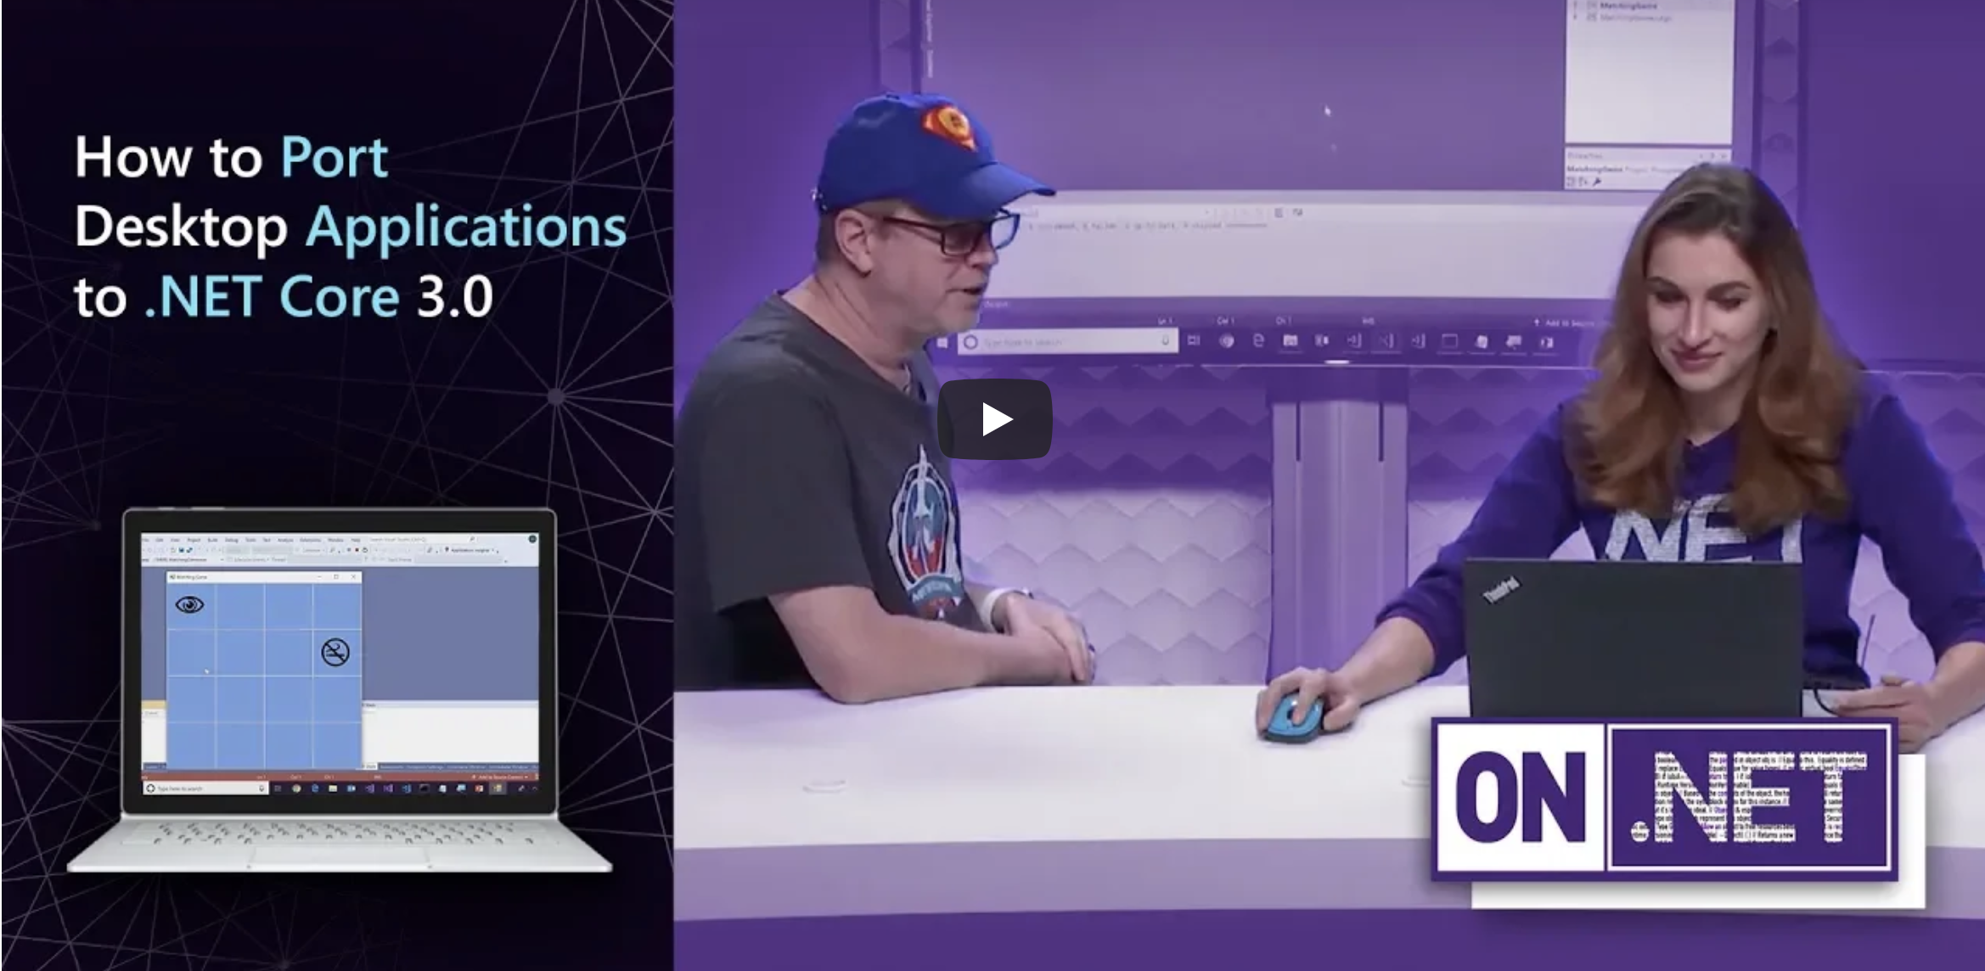
Windows Forms and .NET Core
Learn more at https://aka.ms/netcorewinforms
Learn more about the plans for Windows Forms and .NET Core
Get porting tips and strategies

Slide 36

Web Productivity with Razor Components
Build client-side Web UI in .NET
You don’t need to know AngularJS, React, Vue, etc.
Take advantage of stability and consistency of .NET
Runs in all browsers
Strongly typed on client and server
Share C# code with the client and the server
Web Assembly (Experimental)
Native performance
Requires no plugin or code transpilation
Full-stack web development with C#

Slide 37






Microsoft Cognitive Services
Commoditized AI
Vision
From faces to feelings, allow your apps to understand images and video
Speech
Hear and speak to your users by filtering noise, identifying speakers, and understanding intent
Language
Process text and learn how to recognize what users want
Knowledge
Tap into rich knowledge amassed from the web, academia, or your own data
Search
Access billions of web pages, images, videos, and news with the power of Bing APIs
Labs
An early look at emerging Cognitive Services technologies: discover, try and give feedback on new technologies before general availability
Notes:
Cognitive services uses pretrained models. These are super easy to use set of services for vision recognition, speech and text.

Slide 38
ML.NET
Machine Learning framework made for .NET developers
Build-your-own
Build your own custom models by writing C# or F# code
Developer focused
ML.NET provides just the right amount of productivity and control
Extensible
Tap into other machine learning toolkits with the rich extensibility model like TensorFlow
Proven
ML.NET has been used internally in products like Office and Bing for years
Open source and Cross-platform
Runs on Windows, macOS and Linux and developed in the open on GitHub
https://github.com/dotnet/machinelearning
Notes:
ML.NET is used to develop and integrate custom machine learning models into .NET apps of any type - web, mobile, desktop, gaming, and IoT.
ML.NET is developer focused which means we are going to optimize for common developer scenarios (like recommendation, sentiment analysis)
ML.NET is based upon a decade of internal goodness
ML.NET is open source and cross-platform

Slide 39
A few things you can do with ML.NET …
Sentiment Analysis
Forecasting
Issue Classification
Predictive maintenance
Image classification
Recommendations
Object detection
Customer segmentation
And more! Samples @ https://github.com/dotnet/machinelearning-samples

Slide 40
Demo: Razor Components ML.NET
Notes:
5min

Slide 41
Your platform for building anything
DESKTOP
WEB
CLOUD
MOBILE
GAMING
IoT
AI
.NET
www.dot.net
Notes:
So I hope what we showed you today reinforced our commitment to .NET for building anything you can imagine. It’s the best time to be a .NET developer and we have some very exciting innovations being made to the platform. The ecosystem is growing and it’s thanks to you! Please get involved and learn more on our website.

